Slide 1
DevOps for Every Team

Slide 2
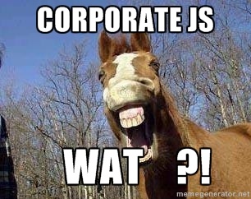
Attila Érsek
Technical Evangelist @ Microsoft
twitter: @ersekattila
github.com/retk

Slide 3

Agility vs Stability
DEV
OPS

Slide 4



Resolving issues without DevOps
There is no problem with my code, you’re either deploying wrong or there is a problem with your infrastructure.
Infrastructure looks good, must be a code problem.
Customer finds problem with your application.
Operations gets notified of application problem.
DEV
OPS

Slide 5
People/Process is what % of downtime?
PROCESS
OPERATIONS
APPLICATION FAILURE
OPERATOR ERROR
Change management
Overloaded
Weak problem detection
Forget something
Lack of procedures
Backup errors/security
40%
40%
OTHER
20%
Hardware/OS
Network
Power and disaster
Gartner Security Conference presentation "Operation Zero Downtime," D. Scott

Slide 6

“DevOps is development and operations collaboration”
“DevOps is treating your infrastructure as code”
It’s DevOps!
It’s DevOps!
“DevOps is using automation”
It’s DevOps!
“DevOps is feature switches”
It’s DevOps!
“DevOps is small deployments”
“Kanban for Ops?”

Slide 7



ALM framework
Source
Build
Deployment
Application
Operations
Cloud
Test/issues
On-premises
Process tools

Slide 8















Open Source Ecosystem
Source
Build
Deploy
App
Ops
GitHub
Codeplex
Chef
Puppet Labs
Public Cloud
Jenkins
Hudson
Microsoft Azure
Alerting
Configuration
Grunt
Gradle
Jenkins
Hudson
Linux
Zabbix
On-premises
Monitor
Test/issues
Gradle
Grunt
Vagrant
Visual Studio
Puppet Labs
Eclipse
Gradle
Grunt
Process tools
Redmine
JIRA

Slide 9






Microsoft Ecosystem
Repository
Build
Deploy
App
Ops
Release Management for Visual Studio
Microsoft Azure
Team Foundation Server
Team Foundation Server
ONE CONSISTENT PLATFORM
Visual Studio Online Application Insights
HockeyApp
ON-PREMISES
SERVICE PROVIDER
OR
Release Management for Visual Studio
Automation Service
TFVC
GIT
System Center
Operations Manager
Test
PowerShell
WAML
Team Foundation Server
Microsoft Test Manager
Microsoft Monitoring Agent
xPlat CLI
Resource Groups
Process tools
Release Management for Visual Studio
Service Manager

Slide 10

PLS

Slide 11
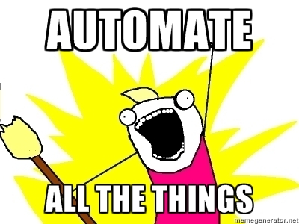
DEMO

Slide 12

wat happened?
path too long (rly!?)
timeouts (storage performance, shared infrastructure, etc)
no complex infrastucture
cloud tests, feedbacks, approvals, etc (unicorns do exist)

Slide 13

Visual Studio Team Services
Code Repository
Build + Deploy
Automated Testing
User Feedback
Backlog
Monitor and improve

Slide 14

Köszönöm!

